Slide 1
Class Object And Interface
Presented by Jamil Rayhan
ID: 18CSE061

Slide 2
Class
A class is a template or blueprint from which objects are created. Before we create an object, we first need to define the class.
We can think of the class as a sketch (prototype) of a house. It contains all the details about the floors, doors, windows, etc. Based on these descriptions we build the house. House is the object. Since many houses can be made from the same description, we can create many objects from a class.

Slide 3
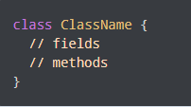
Creating an Class in Java
Here, fields (variables) and methods represent the state and behavior of the object respectively.
fields are used to store data
methods are used to perform some operations
We can create a class in Java using the class keyword. For example .

Slide 4
Object
An object is called an instance of a class.
An object is a real-world entity.
An object is a runtime entity.
Example: Suppose Bicycle is a class then MountainBicycle, SportsBicycle, TouringBicycle, etc can be considered as objects of the class.

Slide 5
To create an Object in Java
By new keyword.
By new instance.
By clone method.
By deserialization
By factory method

Slide 6
Interface
An interface is a reference type in Java.
It is similar to class.
It is a collection of abstract methods.
A class implements an interface, thereby inheriting the abstract methods of the interface.
Along with abstract methods, an interface may also contain constants, default methods, static methods, and nested types.

Slide 7
Why use Java interface
There are mainly three reasons to use interface. They are given below.
It is used to achieve abstraction.
By interface, we can support the functionality of multiple inheritance.
It can be used to achieve loose coupling.

Slide 8
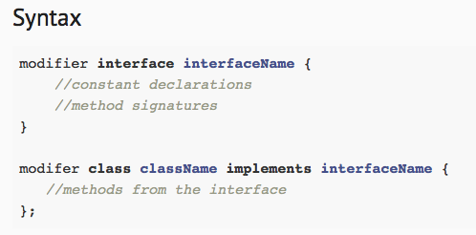
How to declare an interface!
An interface is declared by using the interface keyword.
It provides total abstraction; means all the methods in an interface are declared with the empty body, and all the fields are public, static and final by default.
A class that implements an interface must implement all the methods declared in the interface.
Syntax :

Slide 9
Relationship between Class and Interface
A class extends another class , an interface extends another interface but a class implements an interface.
class
interface
interface
extend
implement
extend
class
class
interface

Slide 10
Difference between class and interface
Class
Interface
Class can instantiate variable & create object.
Class can contain concrete methods.
The access specifiers are privet, protected, and public.
Interface can’t instantiate variable & create object
Interface can’t contain concrete methods.
Only one public specifier is used.

Slide 11
Thank You

